Slide 1

Estate Planning
HOLLINGSWORTH | ROBERTS | MEANS

Slide 2


“What Can I Do to Be Better Prepared for These Uncertain Times?”
While maneuvering through this unexpected time of quarantines, shelter in place, and working from home, the number one question I field is “What can I do to be better prepared if I become ill?” As an estate planner, I work with each client to create a plan to follow in the event of the client’s illness or passing, regardless of the current environment. The plan includes documents for others to make medical and financial decisions when the client is incapacitated and arrangements to take care of the client’s loved ones after passing. Additionally, we have the capability to electronically sign and notarize all documents making in person meetings unnecessary.
The following information is a brief summary of the documents available to better prepare you for these uncertain times.

Slide 3

Estate Planning Documents
Medical Representative
Power of Attorney
Living Will
Last Will and Testament
Family Trust

Slide 4

Medical Representative
What is a Medical Representative?
The appointment of a Medical Representative is a document in which you appoint another person to make medical decisions for you only in the event that you are incapacitated and unable to make the decision. Upon your incapacity your Medical Representative may present the document to your medical staff who will thereafter accept your Medical Representative’s decisions on your behalf.
How is the document used?
If you are rendered unconscious at the hospital, your Medical Representative may present the document to the medical staff and make decisions on what medical actions to take on your behalf.

Slide 5

Power of Attorney
What is the Power of Attorney?
The appointment of a Power of Attorney, sometimes referred to as a durable power of attorney, is a document in which you appoint another person to make non-medical decisions for you either at the time of signing or in the event you are incapacitated. Upon the effective date of your Power of Attorney, your appointed representative may present the document as proof that he is authorized to take the action requested.
How is the document used?
If you are out of town and need to request information in person from your bank, your power of attorney may present the document to take the action in person on your behalf.

Slide 6

Living Will
What is a Living Will?
A Living Will is a statutorily authorized statement from you made now that states whether you want to be provided artificially supplied nutrition and hydration if in the future you have an incurable illness, you will die in a short amount of time and artificial sustenance will only serve to prolong the dying process.

Slide 7

Last Will and Testament
What is a Last Will and Testament?
The Last Will and Testament, also referred to as a Will, is the most familiar estate planning document. Your Will appoints a personal representative to administer your estate upon your death, including payment of outstanding debt and distribution of assets.

Slide 8
Family Trust
What is a Trust?
In most situations, a trust is set up to hold assets after your death to distribute to your family over time and includes an appointment of the trustee to administer the Trust. As an example, you may put assets in a Trust to care for your minor children and make distributions upon reaching certain milestones.
As an example, you name your sister as trustee to administer your Trust to pay for your child’s educational needs through college with a final payout of all remaining assets when your child turns 30 years old.

Slide 9

“How Can I Meet with You to Complete My Estate Documents?”
While we remain vigilant in stopping the spread of the Coronavirus, we have implemented virtual meetings, telephone calls and encrypted messaging to share documents. The State of Indiana also permits electronic signatures, including witnesses and notaries specifically for estate documents.

Slide 10
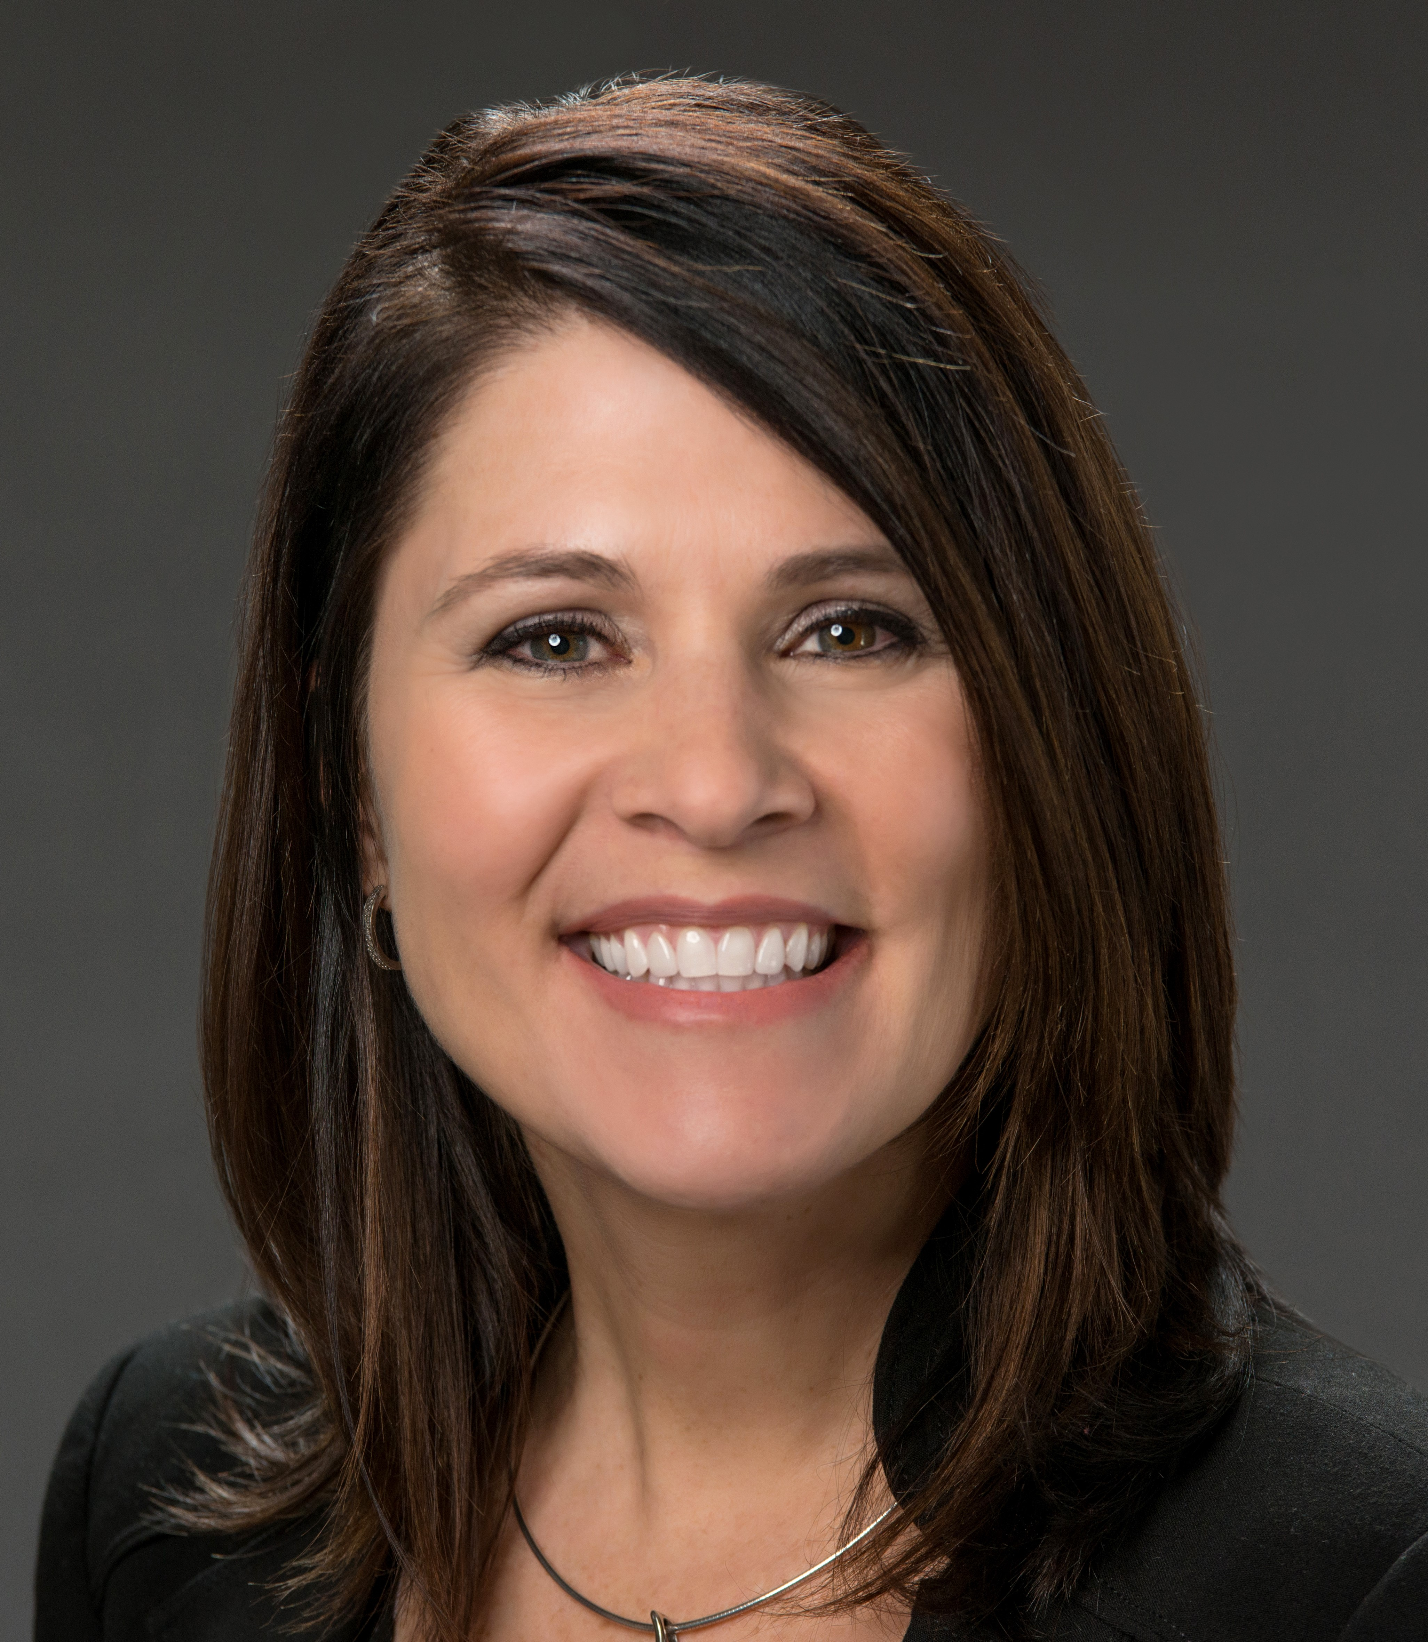
Michelle B. Skaggs
MSkaggs@HRMLaw.com
317-569-2200 ext.1023
Depending on your assets, a more in-depth plan including charitable remainder trusts, transfer on death deeds, designation of beneficiaries, etc… may be recommended.
Due to the Secure Act becoming effective January 1, 2020, it may also be beneficial to discuss options to transfer your tax deferred retirement assets with the end to the majority of the options to stretch the payments based on your beneficiary’s life.

